Slide 1
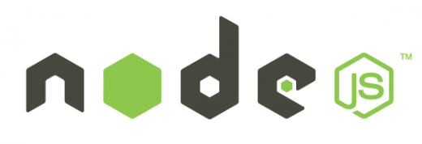
Node.js
Module 10 – Hosting Complex Node Architectures with Docker

Slide 2
Agenda
What is Docker
Docker CLI
Docker File system & Volumes
Docker Files
Containers Communication
Docker Compose

Slide 3
Node Architectures
Modern days Node applications usually have dependencies such as databases, caches, queues and other node services.
Node applications can also be setup behind load balancers and reverse proxies.
Docker allows you to package an application with all of its dependencies into a standardized unit, called a container.

Slide 4
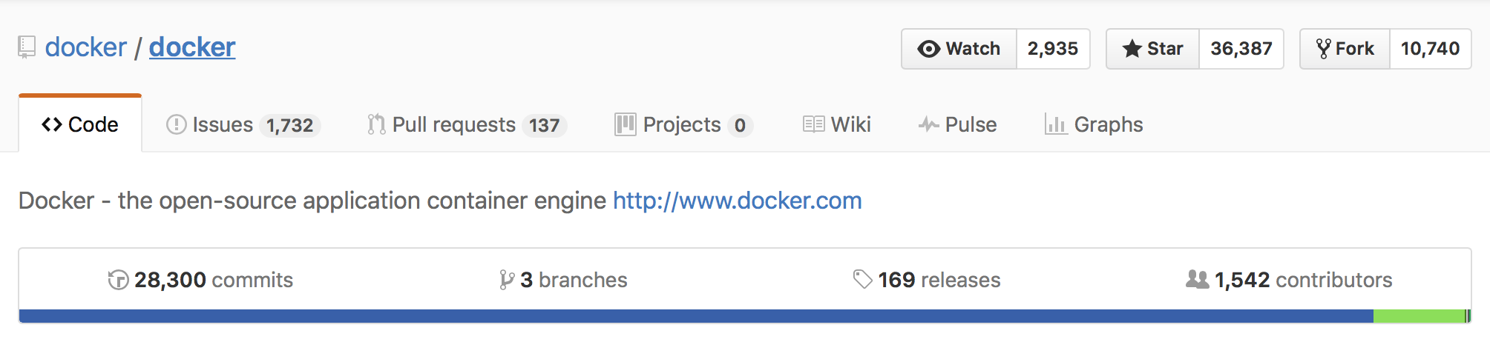

Docker - What is Docker ?
Docker is an open source project on github
https://github.com/docker/docker
Notes:
https://blog.docker.com/2015/10/docker-basics-webinar-qa/
https://github.com/docker/docker

Slide 5
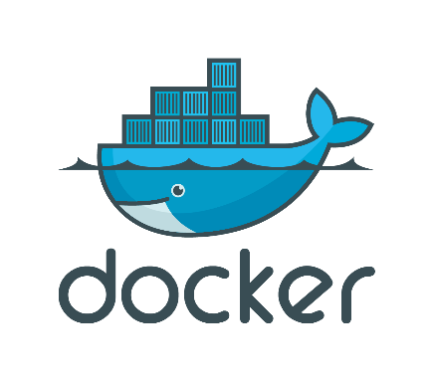


Docker History
a Paas (Platform as a service) company
Manages Infrastructure for developers who don’t want to handle infra by them self
Around 2012 – 2013 dotCloud opened source the core technology of the company as a side project named Docker
Solomon Hykes

Slide 6
What Are Containers
Containers are the next evolution in virtualization.
Containers are an isolated, resource controlled, and portable operating environment.
Basically, a container is an isolated place where an application can run without affecting the rest of the system and without the system affecting the application.
If you were inside a container, it would look very much like you were inside a freshly installed physical computer or a virtual machine.

Slide 7














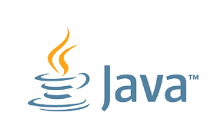

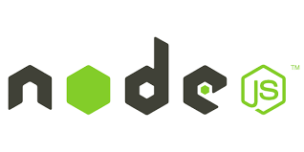

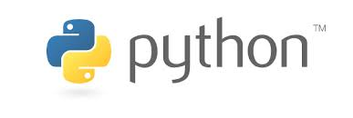
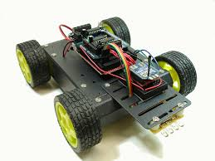
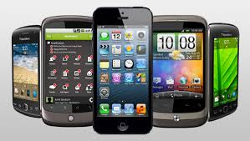
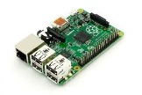
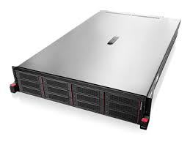
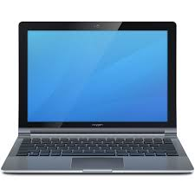
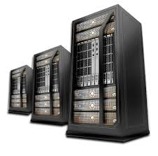
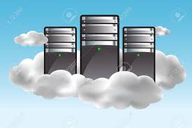
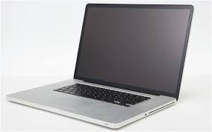
Why Docker

Slide 8

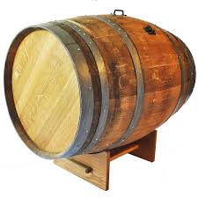


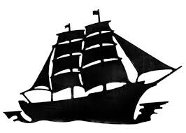

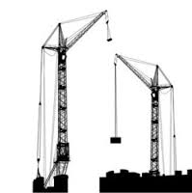
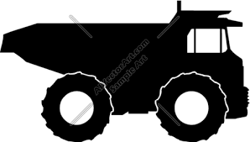
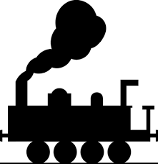
The Matrix From Hell
? | ? | ? | ? | ? | ?
? | ? | ? | ? | ? | ?
? | ? | ? | ? | ? | ?
? | ? | ? | ? | ? | ?
? | ? | ? | ? | ? | ?

Slide 9
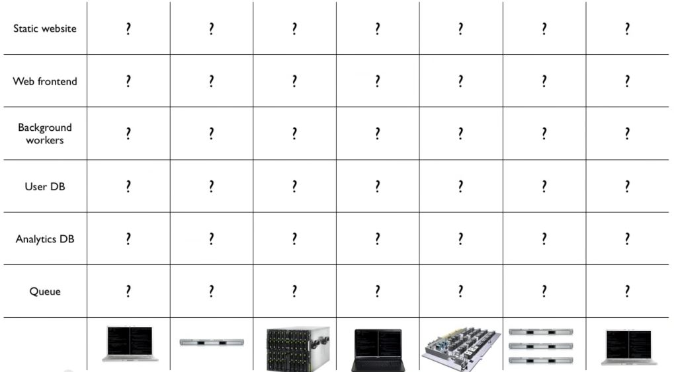
The Matrix From Hell

Slide 10
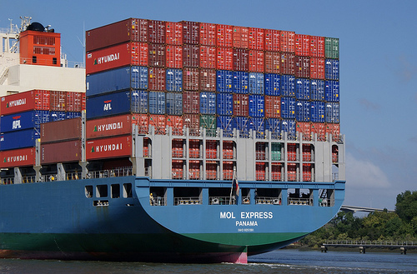
Shipping Industry Solution

Slide 11
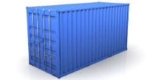
Shipping Industry Solution
? | ? | ? | ? | ? | ?
? | ? | ? | ? | ? | ?
? | ? | ? | ? | ? | ?
? | ? | ? | ? | ? | ?
? | ? | ? | ? | ? | ?

Slide 12
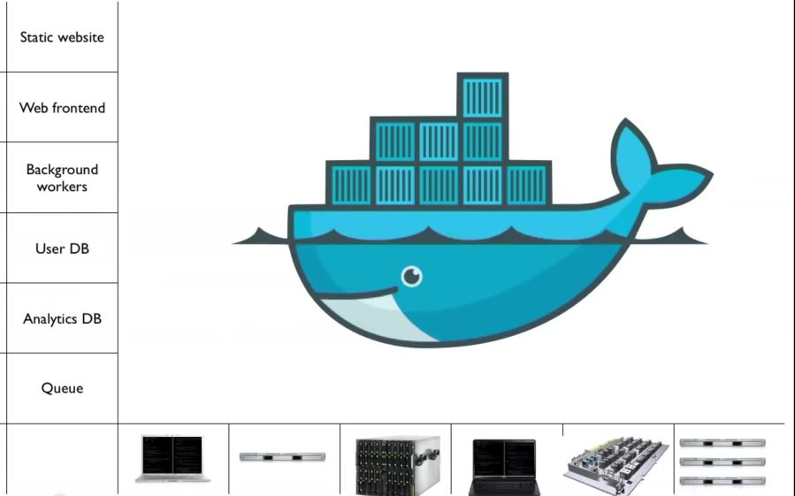
Docker Solution

Slide 13
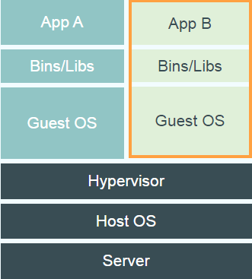
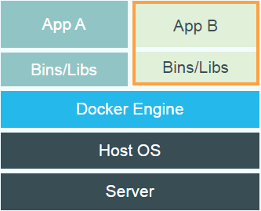
VM vs. Docker
Virtual Machines
Each virtualized application includes not only the application - which may be only 10s of MB - and the necessary binaries and libraries, but also an entire guest operating system - which may weigh 10s of GB.
Docker
The Docker Engine container comprises just the application and its dependencies. It runs as an isolated process in userspace on the host operating system, sharing the kernel with other containers. Thus, it enjoys the resource isolation and allocation benefits of VMs but is much more portable and efficient.

Slide 14


Docker Mission
Build
Ship
Run
Distributed Applications
App
App
App
App
App
App
App
App
Run Anywhere
Notes:
https://blog.docker.com/2015/10/docker-basics-webinar-qa/

Slide 15

Write Once Run Anywhere
{J,W,E} AR
Mac OS X
Windows
Linux
Unix
Notes:
https://blog.docker.com/2015/10/docker-basics-webinar-qa/

Slide 16

Package Once Run Anywhere
Docker Image
Mac OS X
Windows
Linux
Unix
Notes:
https://blog.docker.com/2015/10/docker-basics-webinar-qa/

Slide 17
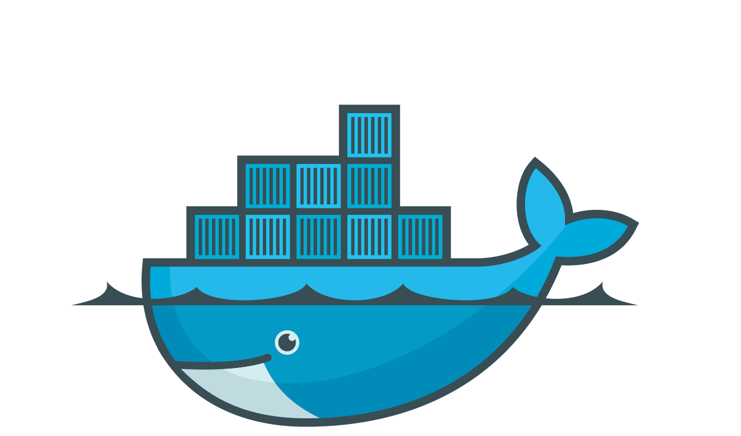
Docker Demo

Slide 18
Container Fundamentals
Container Host: - Physical or Virtual computer system configured with the Windows Container feature.
Container OS Image: - Containers are deployed from images. The container OS image is the first layer in potentially many image layers that make up a container. This image provides the operating system environment.
Container Image: - A container image contains the base operating system, application, and all application dependencies needed to quickly deploy a container.
Container Registry: - Container images are stored in a container registry, and can be downloaded on demand.
Dockerfile: - Dockerfiles are used to automate the creation of container images.

Slide 19
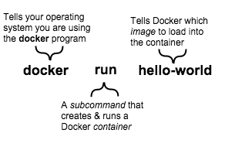
Docker CLI (command line interface)
Docker Engine provides the core Docker technology that enables images and containers. As the last step in your installation, you ran the docker run hello-world command. The command you ran had three parts.

Slide 20
Docker run …
$ docker run [OPTIONS] IMAGE[:TAG|@DIGEST] [COMMAND] [ARG...]
The docker run command must specify an IMAGE to derive the container from. An image developer can define image defaults related to:
- detached or foreground running
- container identification
- network settings
- runtime constraints on CPU and memory
Notes:
https://docs.docker.com/engine/reference/commandline/run/

Slide 21
Docker ps
$ docker ps
docker ps command will list the running containers on your host
docker ps -a command will list the running and aborted containers on your host
$ docker ps CONTAINER ID IMAGE COMMAND CREATED STATUS PORTS NAMES
5f35bb815832 registry:2 "/bin/registry /etc/d" 8 months ago Up 3 hours 0.0.0.0:5000->5000/tcp registry

Slide 22
Docker images
$ docker images
The default docker images will show all top level images, their repository and tags, and their size.
Docker images have intermediate layers that increase reusability, decrease disk usage, and speed up docker build by allowing each step to be cached. These intermediate layers are not shown by default.

Slide 23
Listing images filter by tag/name
The docker images command takes an optional [REPOSITORY[:TAG]] argument that restricts the list to images that match the argument. If you specify REPOSITORY but no TAG, the docker images command lists all images in the given repository.
$ docker images java

Slide 24
Docker pull
$ docker pull [OPTIONS] NAME[:TAG|@DIGEST]
Docker pull downloads an image from a registry (docker hub by default).
Docker hub registry contains the official and community images for node.js.

Slide 25
Docker Basic Lab

Slide 26
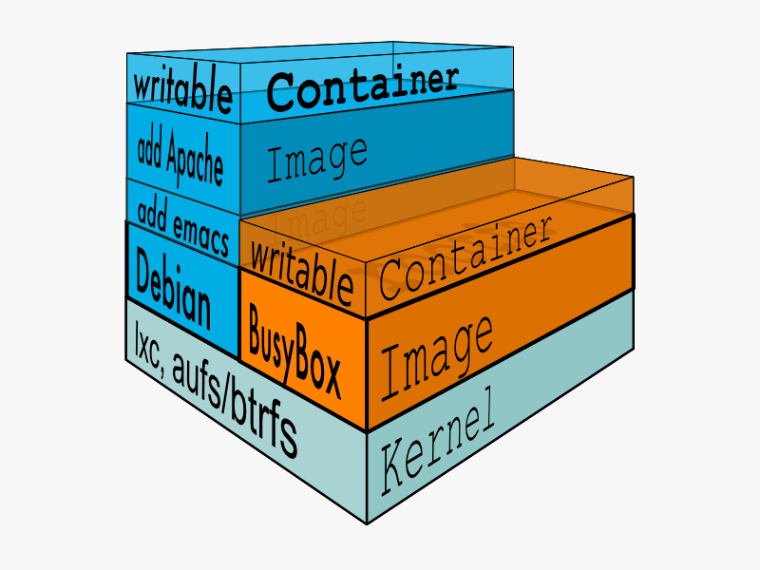
Docker Images Are Layered
Docker images are built as layers. Each layer represents a portion of the images file system that either adds to or replaces the layer below. For instance you can start with a an Ubuntu image, add your application source code, and the Apache server. The changes will be captured only on the top layer.
Notes:
https://blog.docker.com/2015/10/docker-basics-webinar-qa/

Slide 27
What is a union file system?
A union file system is a file system that uses a collection of different file systems and directories (called branches) into a single logical file system. Each branch is a layer in the docker image
When a container starts a writable layer is added on top of the container top branch
Notes:
https://blog.docker.com/2015/10/docker-basics-webinar-qa/

Slide 28
Why
Very efficient
Sub second container instantiation time
New container will add less then 1mb
No data is duplicated on disk
Notes:
https://blog.docker.com/2015/10/docker-basics-webinar-qa/

Slide 29
Data Volumes
A data volume is a specially-designated directory within one or more containers that bypasses the Union File System Data volumes provide several useful features for persistent or shared data:
Volumes are initialized when a container is created. If the container’s base image contains data at the specified mount point, that existing data is copied into the new volume upon volume initialization. (Note that this does not apply when mounting a host directory.)
Data volumes can be shared and reused among containers.
Changes to a data volume are made directly.
Changes to a data volume will not be included when you update an image.
Data volumes persist even if the container itself is deleted.
Notes:
https://blog.docker.com/2015/10/docker-basics-webinar-qa/

Slide 30
Create a data Volume
Create a volume by adding the –v flag to the run command.
$ docker run –v /var/www node
You can locate the volume on the host by utilizing the docker inspect command.
$ docker inspect web
... "Mounts": [
{ "Name": "fac362...80535",
"Source": "/var/lib/docker/volumes/fac362...80535/_data",
"Destination": "/webapp",
…
} ]
...
Notes:
https://blog.docker.com/2015/10/docker-basics-webinar-qa/

Slide 31
Use Host Directory As Data Volume
The –v flag value would include a mapping between the host directory and the container directory separated by a :
$ docker run –v [host directory]:[container directory] node
Use the $(pwd) placeholder to map the current working directory
$ docker run –v $(pwd):/var/www node
Notes:
https://blog.docker.com/2015/10/docker-basics-webinar-qa/

Slide 32
Port Mapping
Node apps are usually servers that are listening on a specific port.
In order for us to be able to browse our node app, we need to map the host port to the container port the app is listening.
To map a port use the –p flag in the run command
The –p flag value would include a mapping between the host directory and the container directory separated by a
$ docker run –v $(pwd):/var/www –p 8080:3000 node

Slide 33
Express in a Container

Slide 34
Container As Definition
Docker can build images automatically by reading the instructions from a Dockerfile. A Dockerfile is a text document that contains all the commands a user could call on the command line to assemble an image. Using docker build users can create an automated build that executes several command-line instructions in succession.

Slide 35
Dockerfile
FROM ubuntu:14.04
RUN \
apt-get update && \
apt-get -y install apache2
VOLUME /myvol
ADD index.html /var/www/html/index.html
EXPOSE 80
CMD ["/usr/sbin/apache2ctl", "-D", "FOREGROUND"]

Slide 36
Dockerfile instructions – FROM
The FROM instruction sets the Base Image for subsequent instructions. As such, a valid Dockerfile must have FROM as its first instruction. The image can be any valid image – it is especially easy to start by pulling an image from dockerhub.
FROM <image>
FROM <image>:<tag>

Slide 37
Dockerfile instructions – ENTRYPOINT
An ENTRYPOINT allows you to configure a container that will run as an executable.
ENTRYPOINT [“npm”,”start”]

Slide 38
Dockerfile instructions - CMD
The main purpose of a CMD is to provide defaults for an executing container. These defaults can include an executable, or they can omit the executable, in which case you must specify an ENTRYPOINT instruction as well.
FROM ubuntu CMD echo "This is a test." | wc -

Slide 39
Dockerfile instructions - RUN
The RUN instruction will execute any commands in a new layer on top of the current image and commit the results. The resulting committed image will be used for the next step in the Dockerfile.
FROM <image>
FROM <image>:<tag>

Slide 40
Dockerfile instructions - EXPOSE
The EXPOSE instruction informs Docker that the container listens on the specified network ports at runtime.EXPOSE does not make the ports of the container accessible to the host. To do that, you must use either the -p flag to publish a range of ports or the -P flag to publish all of the exposed ports. You can expose one port number and publish it externally under another number.
EXPOSE <port> [<port>...]

Slide 41
Dockerfile instructions - COPY
The COPY instruction copies new files or directories from <src> and adds them to the filesystem of the container at the path <dest>.
Multiple <src> resource may be specified but they must be relative to the source directory that is being built (the context of the build).
Each <src> may contain wildcards and matching will be done using Go’s filepath.Match rules.
COPY hom* /mydir/ # adds all files starting with "hom" COPY hom?.txt /mydir/ # ? is replaced with any single character, e.g., "home.txt"

Slide 42
Dockerfile instructions - VOLUME
The VOLUME instruction creates a mount point with the specified name and marks it as holding externally mounted volumes from native host or other containers. The value can be a JSON array, VOLUME ["/var/log/"], or a plain string with multiple arguments, such as VOLUME /var/log or VOLUME /var/log /var/db. For more information/examples and mounting instructions via the Docker client, refer to Share Directories via Volumes documentation.
VOLUME ["/data"]

Slide 43
Dockerfile instructions - ENV
The ENV instruction allows you to assign environment variables.
ENV NODE_ENV=production

Slide 44
Dockerfile instructions - WORKDIR
The WORKDIR instruction sets the working directory for any RUN, CMD, ENTRYPOINT, COPY and ADD instructions that follow it in the Dockerfile
ENV NODE_ENV=production

Slide 45
Build Command
We use the build command to package a container form a Dockerfile. The build process will run on the docker daemon that will use the context we will provide on the build command. The Build command can use one of the options as a build context
PATH
URL
TAR file

Slide 46
Build From Path
$ docker build –t name:tag .
This example specifies that the PATH is . , and so all the files in the local directory get tard and sent to the Docker daemon. The PATH specifies where to find the files for the “context” of the build on the Docker daemon. Remember that the daemon could be running on a remote machine and that no parsing of the Dockerfile happens at the client side (where you’re running docker build). That means that all the files at PATH get sent, not just the ones listed to ADD in the Dockerfile.

Slide 47
Build Naming and Tags
You should normally use a some kind of naming and taging when building a container.
Tags can be used to manage container versions or branches.
Use –t or –tag to name our container in the format of -t name:tag -t username/container_name:tag
$ docker build –t name:tag https://github.com/docker/rootfs.git#container:docker
$ docker build –t name:tag .
$ docker build –t name:tag http://server/context.tar.gz

Slide 48
Docker Files Lab

Slide 49
Containers Communication
One of the reasons Docker containers are so powerful is that you can connect them together.
In order for container to communicate they need to be in the same network

Slide 50
Network Create
Docker Engine creates a bridge network automatically when you install the Engine.
In addition to this network, you can create your own bridge or overlay network.
If you run docker network create and supply only a network name, it creates a bridge network for you.
//create a network
docker network create [NETWORK_NAME]
//list all networks
docker network ls
//show network details
docker network inspect [NETWORK_NAME | NETWORK_ID]
Notes:
https://docs.docker.com/engine/userguide/networking/work-with-networks/#linking-containers-in-user-defined-networks

Slide 51
Connect to a network
When running a container using the run command, you can connect it to a network by using the –-net flag
Once inside a network you can connect to another container by their name.
//run node app container inside the isolated_network network
docker run –d --net=isolated_network –-name nodeapp sela/my-node-app
//run mongo container inside the isolated_network network
docker run –d --net=isolated_network –-name mongodb mongo
Notes:
https://docs.docker.com/engine/userguide/networking/work-with-networks/#linking-containers-in-user-defined-networks

Slide 52
Networks Lab

Slide 53
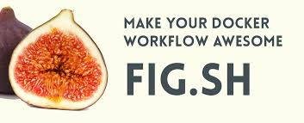
Multiple Container With Compose
Compose is a tool for defining and running complex applications with Docker. With compose, you define a multi-container application in a single file, then spin your application up in a single command which does everything that needs to be done to get it running.
Also known as : docker-compose, fig

Slide 54
Docker-compose File
The Compose file is a YAML file defining services, networks and volumes.
Docker-compose is YML file and it is spaced not tabbed
version: '3'
services:
web: build: .
ports: - "5000:5000"
volumes:
- .:/code
- logvolume01:/var/log
links:
- redis
redis:
image: redis
volumes: logvolume01: {}

Slide 55
Basic Commands - Compose up
The docker-compose up will start all the containers listed in the “docker-compose.yml” file based on the dependencies in the file. Running docker-compose up -d starts the containers in the background and leaves them running.
$ docker-compose up -d

Slide 56
Basic Commands - Compose ps
List all the containers belong to the compose environment instance
$ docker-compose ps

Slide 57
Preserve Volume data
Preserve volume data when containers are created.
Compose preserves all volumes used by your services.
When docker-compose up runs, if it finds any containers from previous runs, it copies the volumes from the old container to the new container.
This process ensures that any data you’ve created in volumes isn’t lost.

Slide 58
Container Changed Aware
Only recreate containers that have changed
Compose caches the configuration used to create a container.
When you restart a service that has not changed, Compose re-uses the existing containers.
Re-using containers means that you can make changes to your environment very quickly.

Slide 59
Variables
Variables for moving a composition between environments
Compose supports variables in the Compose file. You can use these variables to customize your composition for different environments, or different users.
web:
build: .
ports:
- "${EXTERNAL_PORT}:5000"

Slide 60
Networks
By default Compose sets up a single network for your app. Each container for a service joins the default network and is both reachable by other containers on that network, and discoverable by them at a hostname identical to the container name.
Notes:
https://docs.docker.com/compose/networking/

Slide 61
Networks
When you run docker-compose up, on the compose file below. the following happens:
A network called myapp_default is created.
A container is created using web’s configuration. It joins the network myapp_default under the nameweb.
A container is created using db’s configuration. It joins the network myapp_default under the namedb.
version: '3'
services:
web:
build: .
ports: - "8000:8000"
db:
image: postgres

Slide 62
Networks
Now each container can now look up the hostname web or db and get back the appropriate container’s IP address. For example, web’s application code could connect to the URL postgres://db:5432 and start using the Postgres database.
Because web explicitly maps a port, and also accessible from the outside world via port 8000 on your Docker host’s network interface.
version: '2'
services:
web:
build: .
ports: - "8000:8000"
db:
image: postgres

Slide 63
Compose Lab
Notes:
https://docs.docker.com/compose/reference/overview/
https://docs.docker.com/compose/compose-file/
https://docs.docker.com/compose/gettingstarted/

